Slide 1
FUNCTION-ORIENTED SOFTWARE DESIGN

Slide 2
Context Diagram-Level 0 DFD
The context diagram is the most abstract (highest level) data flow representation of a system.
It represents the entire system as a single bubble. The bubble in the context diagram is annotated with the name of the software system being developed (usually a noun).
Example: software developed to automate the book keeping activities of a supermarket has been labelled as ‘Supermarket software’

Slide 3
Context Diagram-Level 0 DFD
The context diagram establishes the context in which the system operates; that is, who are the users, what data do they input to the system, and what data they received by the system.
The various external entities with which the system interacts and the data flow occurring between the system and the external entities are represented.
The data input to the system and the data output from the system are represented as incoming and outgoing arrows.
These data flow arrows should be annotated with the corresponding data names.

Slide 4
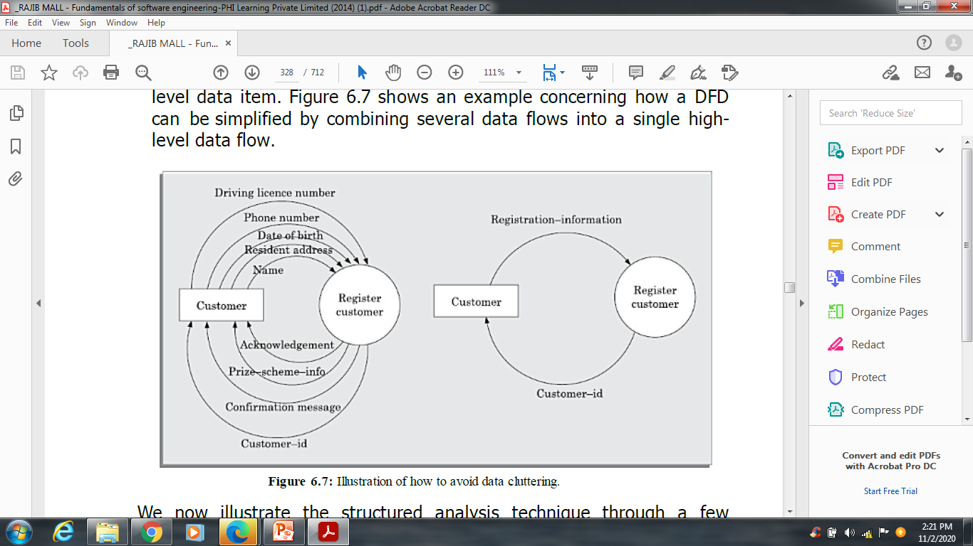
Context Diagram-Level 0 DFD
0

Slide 5
Level 1- DFD
The level 1 DFD usually contains three to seven bubbles.
To develop the level 1 DFD, examine the high-level functional requirements in the SRS document.
Examine the input data to these functions and the data output by these functions as documented in the SRS document and represent them appropriately in the diagram.

Slide 6
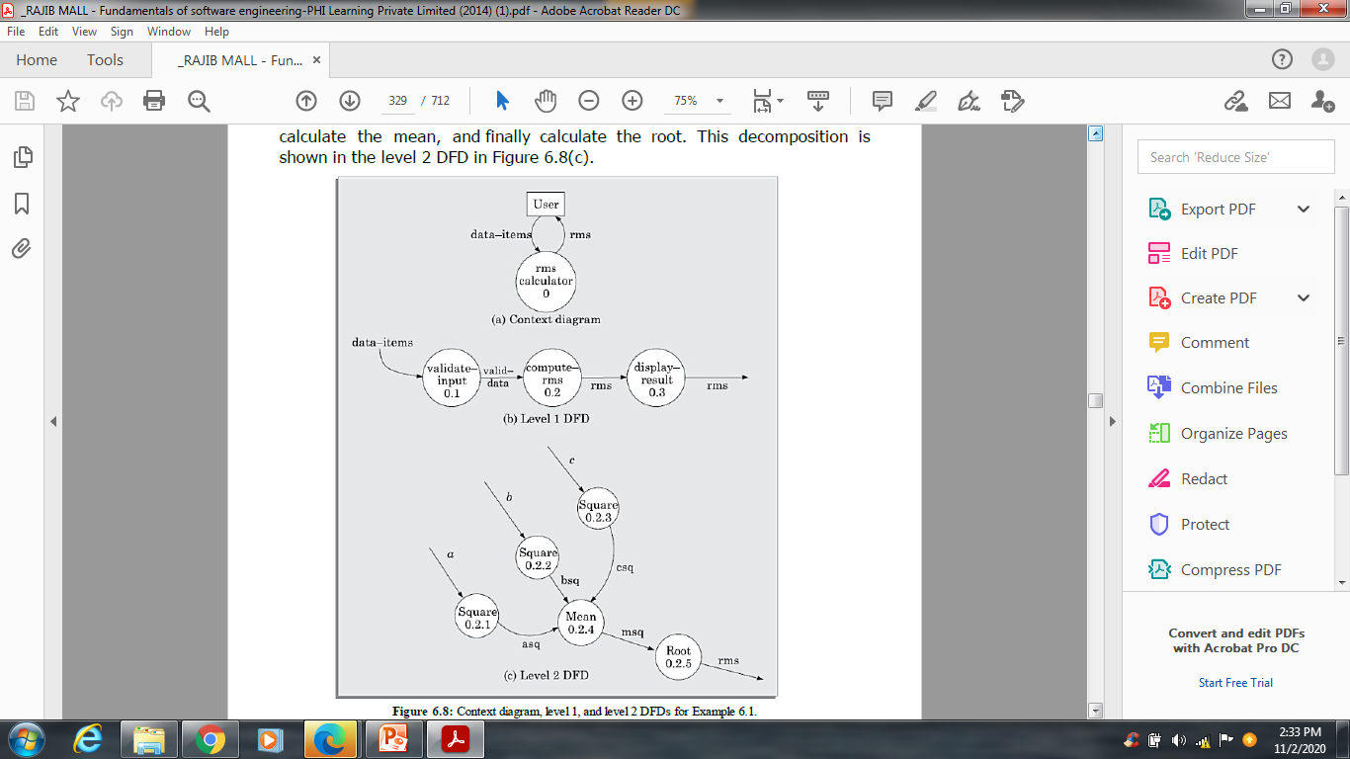
Level 1- DFD

Slide 7
Level 1- DFD
Data dictionary for the DFD model of Example 6.1
data-items: {integer}3
rms: float
valid-data:data-items
a: integer
b: integer
c: integer
asq: integer
bsq: integer
csq: integer
msq: integer

Slide 8
DFD’s
Each bubble in the DFD represents a function performed by the system. The bubbles are decomposed into sub-functions at the successive levels of the DFD model.
Decomposition of a bubble is also known as factoring or exploding a bubble.
Decomposition of a bubble should be carried on until a level is reached at which the function of the bubble can be described using a simple algorithm.

Slide 9
DFD’s
Construction of context diagram: Examine the SRS document to determine:
• Different high-level functions that the system needs to perform.
• Data input to every high-level function.
• Data output from every high-level function.
• Interactions (data flow) among the identified high-level functions.
Represent these aspects of the high-level functions in a diagrammatic form. This would form the top-level data flow diagram (DFD), usually called the DFD 0.

Slide 10
DFD’s
Construction of level 1 diagram:
Examine the high-level functions described in the SRS document. If there are three to seven high-level requirements in the SRS document, then represent each of the high-level function in the form of a bubble. If there are more than seven bubbles, then some of them have to be combined. If there are less than three bubbles, then some of these have to be split.

Slide 11
DFD’s
Construction of lower-level diagrams: Decompose each high-level function into its constituent sub-functions through the following set of activities:
• Identify the different sub-functions of the high-level function.
• Identify the data input to each of these sub-functions.
• Identify the data output from each of these sub-functions.
• Identify the interactions (data flow) among these sub-functions.
Represent these aspects in a diagrammatic form using a DFD.

Slide 12
DFD’s
Numbering of bubbles
These numbers help in uniquely identifying any bubble in the DFD from its bubble number.
The bubble at the context level is usually assigned the number 0 to indicate that it is the 0 level DFD.
Bubbles at level 1 are numbered, 0.1, 0.2, 0.3, etc. When a bubble numbered x is decomposed, its children bubble are numbered x.1, x.2, x.3, etc.

Slide 13
DFD’s
Balancing DFDs
The data that flow into or out of a bubble must match the data flow at the next level of DFD. This is known as balancing a DFD.
How far to decompose?
A bubble should not be decomposed any further once a bubble is found to represent a simple set of instructions. For simple problems, decomposition up
to level 1 should suffice. However, large industry standard problems may need decomposition up to level 3 or level 4. Rarely, if ever, decomposition beyond level 4 is needed.

Slide 14
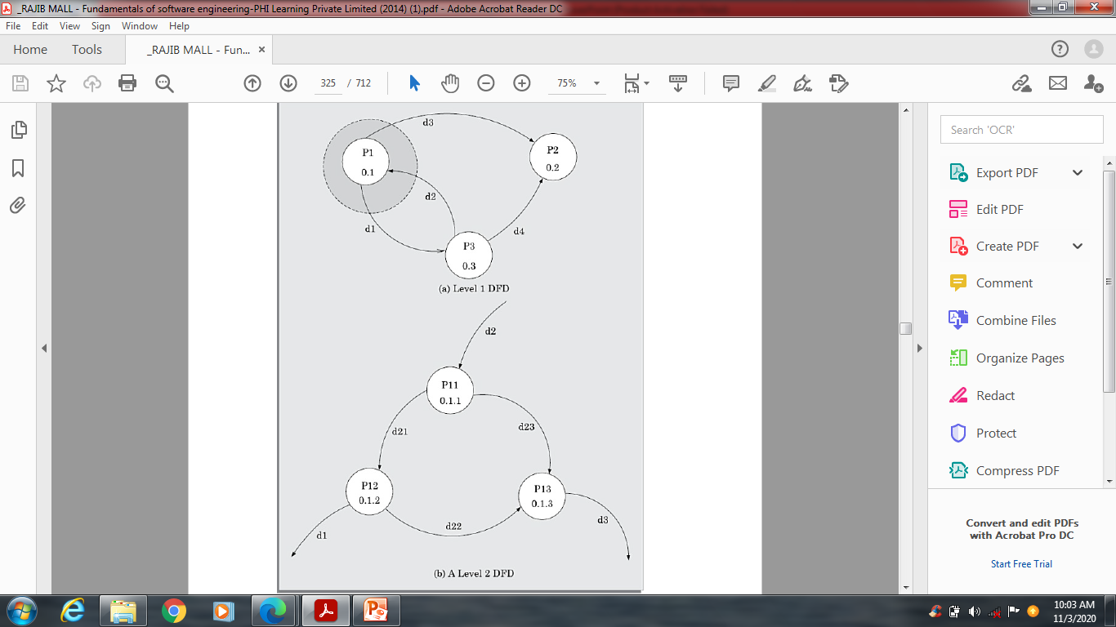
Balancing DFD

Slide 15
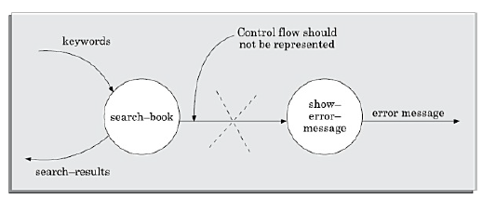
Things to remember
It is important to realize that a DFD represents only data flow, and it does not represent any control information.

Slide 16
Things to remember
Many beginners commit the mistake of drawing more than one bubble in the context diagram. Context diagram should depict the system as a single bubble.
Many beginners create DFD models in which external entities appearing at all levels of DFDs. All external entities interacting with the system should be represented only in the context diagram. The external entities should not appear in the DFDs at any other level.
It is a common oversight to have either too few or too many bubbles in a DFD. Only three to seven bubbles per diagram should be allowed. This also means that each bubble in a DFD should be decomposed three to seven bubbles in the next level.

Slide 17
Things to remember
Many beginners leave the DFDs at the different levels of a DFD model unbalanced.
A common mistake committed by many beginners while developing a DFD model is attempting to represent control information in a DFD.

Slide 18
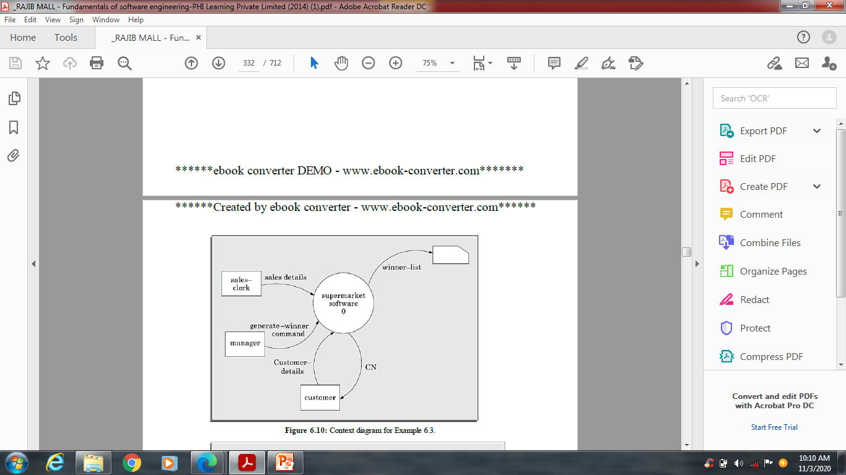
Example of DFD

Slide 19
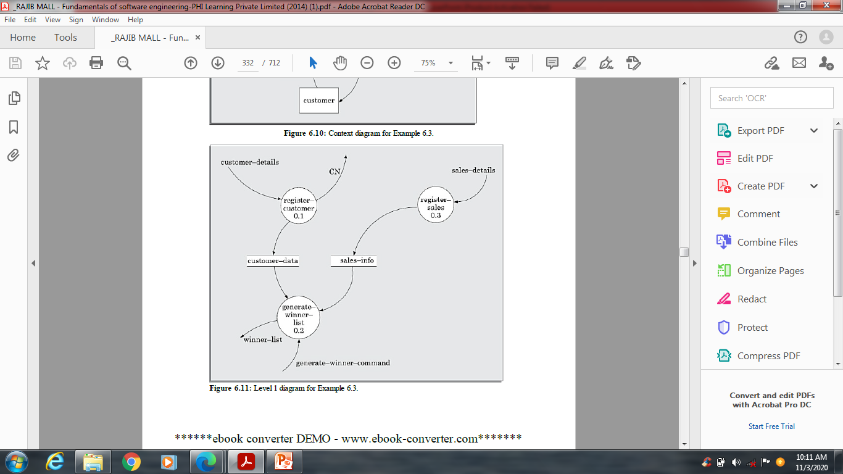
Example of DFD

Slide 20
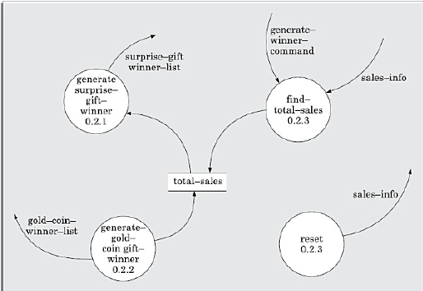
Example of DFD

Slide 21
Example of DFD
Data dictionary for the DFD model of Example
address: name+house#+street#+city+pin
sales-details: {item+amount}* + CN
CN: integer
customer-data: {address+CN}*
sales-info: {sales-details}*
winner-list: surprise-gift-winner-list + gold-coin-winner-list
surprise-gift-winner-list: {address+CN}*
gold-coin-winner-list: {address+CN}*
gen-winner-command: command
total-sales: {CN+integer}*

Slide 22
Any question?

